Slide 1
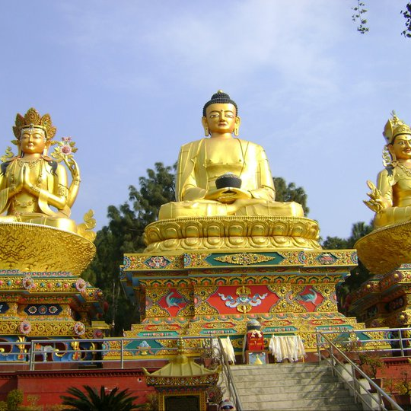

:jfutd\

Slide 2

ljZj hg;+Vof lbj; @)&% sf] cj;/df cfof]lht cGt/lqmof sfo{qmd
j]lg3f6 /f]/fª ufpFkflnsf
k|:tf]tstf{M
b]a/fh 3nfg

Slide 3


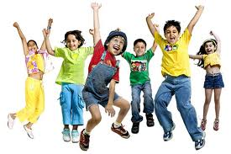


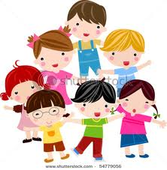
hg;+Vof

Slide 4
kl/ro
!_ hg;+Vofsf] cy{ / kl/efiffM
lglZrt ef}uf]lns If]q leq a;f]af; ug]{ dflg;x?sf] ;+VofnfO{ To; 7fpFsf] hg;+Vof elgG5 .

Slide 5
@_ hg;+Vofsf] dxTj
b]zsf] gLlt tyf sfo{qmdx? th'{df ug{ .
b]zsf] ljsf; lgdf{0fsf]nflu cfjZos hgzlStsf] n]vfhf]vf ug{.
pknaw ;|f]t / ;fwgsf] kl/rfng ul/ b]znfO{ ;d[Wb agfpg .
hgug0ff sfo{nfO{ k|efjsf/L agfpg .

Slide 6
#_ g]kfnsf] hg;+Vofsf] ljz]iftfx?M
hg;+Vofsf] ljzfn cfsf/ .
pRr hg;+Vof j[lWbb/ .
hg;+Vofsf] ljt/0fdf c;dfgtf .
hg3gTjdf c;dfgtf .
o'jf hg;+Vofsf] jfx'Notf .
dlxnfx?sf] jfx'Notf .
pRr k|hgg\ b/ .
36\bf] d[To'b/ .
ljjfxsf] Jokstf .
pRr cfl>t cg'kft .
;fIf/tf k|ltztdf sdL .
>dzlStsf] jfx'Notf .

Slide 7
ljZjsf] hg;+Vof l:ylt
jif{ | hg;+Vof | j[lWbb/
!)))) BC | ! – !) nfv | –
%))) BC | % nfv – !) s/f]8 | –
! AD | )=@% ca{ | –
!^%) AD | )=%) ca{ | )=!
!&%) AD | )=&) ca{ | )=#
!*)$ AD | !=) ca{ | )=%
!(@& AD | @=) ca{ | !=)&
!(*& AD | %=) ca{ | !=^
!((( AD | ^=) ca{ | !=%
@)!! AD | &=) ca{ | !=@
@)!@ AD | &=)% ca{ | !=@
@)!^ AD | &=$!* ca{ | !=@
@)!& AD | &=%) ca{ | !=@

Slide 8
ljZjsf] hg;+Vof l:yltM
s'n hg;+VofM &^#$**$())
hg;+Vofsf] cfwf/df k|d'v ltg 7'nf /fi6«x?M
rfOgfM !$!%!*$^@$
ef/tM !#%$$@^##^
cd]l/sfM #@^*@%@^^
;a}eGbf sd hg;+VofM
xf]nL ;LM *)! hgf

Slide 9
g]kfnsf] hg;+Vof l:yltM
hgug0ff jif{ | s'n hg;+Vof | j[lWbb/ | kl/jt{g | bf]Aa/ x'g nfUg] ;do
1911 | 5638749 | – | – | –
1920 | 5573788 | –0=13 | –^$(^! | –
1930 | 5532574 | –0=07 | –$!@!$ | –
1941 | 6083649 | 1=16 | 751075 | 60
1952÷54 | 8256625 | 2=30 | 1972976 | 31
1961 | 9412996 | 1=65 | 1156371 | 42
1971 | 11555986 | 0=07 | 2142987 | 34
1981 | 15022839 | 2=62 | 3466856 | 27
1991 | 18491097 | 2=10 | 3468258 | 33
2001 | 23151423 | 2=25 | 4660326 | 31
2011 | 26494504 | 1=35 | 3343081 | 52

Slide 10
ef}uf]lns If]qcg';f/ g]kfnsf] hg;+VofM
ef}uf]lns If]q | If]qkmn k|ltztdf | hg;+Vof k|ltztdf @))! | hg;+Vof k|ltztdf @)!!
lxdfn | 35=2 | 7=29 | 6=73
kxf8 | 41=7 | 44=28 | 43=00
t/fO{ | 23=1 | 48=43 | 50=27
hDdf | 100 | 100 | 100

Slide 11
ljsf; If]q cg';f/sf] hg;+Vof ljt/0fM
ljsfz If]q | @))! | @)!! | If]qkmn ju{ ls= ld=
k"jf{~rn | 23=08 | 21=93 | 28456
dWodf~rn | 34=69 | 36=45 | 27410
klZrdf~rn | 19=74 | 18=60 | 29398
d= klZrdf~rn | 13=01 | 13=39 | 42378
;"= klZrdf~rn | 9=47 | 9=63 | 19539
hDdf | 100 | 100 | 100

Slide 12
g]kfnsf] ;a}eGbf al9 / sd hg;+Vof ePsf] % lhNnfx?M
;a} eGbf al9 hg;+Vof ePsf] |  | ;a} eGbf ds hg;+Vof ePsf]
lhNnf | ;g\ @)!! | lhNnf | ;g\ @)!!
sf7df08f} | 1744260 | x'Dnf | 50858
df]/ª | 965370 | /;'jf | 43300
?kGb]xL | 880196 | 8f]Nkf | 36700
emfkf | 812650 | d':tfª | 13452
wg'iff | 775709 | dgfª | 6538

Slide 13
wflbª lhNnfsf] hg;+Vof ljj/0fM
la= ;+= @)^* sf] hgu0fgfg';f/M
hDdf hg;+Vof – ##^@%)
k'?if hg;+Vof – !%&(@*
dlxnf hg;+Vof – !&*#@@

Slide 14
wflbª lhNnfsf] hg;+Vof ljj/0fM
@)&$÷&% sf] /]s8{ cg';f/M
s'n hg;+Vof M #$(*@&
hDdf k'?ifM !^@(@&
hDdf dlxnfM !*&())
! jif{ d'lgsfM &&*#
^) jif{ eGbf dflysfM @(*#*
ue{jtL dlxnfM ($*#
lhljt lzz'sf] hGdM *)$@

Slide 15
j]lg3f6 /f]/fª ufpFkflnsfsf] hg;+Vof ljj/0fM
s'n hg;+Vof M ##)$(
hDdf k'?ifM !^$&^
hDdf dlxnfM !^%&^
^) jif{ eGbf dflysfM @!&&
ue{jtL dlxnfM *(^
lhljt lzz'sf] hGdM &#%

Slide 16
;fljssf] uflj;x?sf] hg;+Vof ljj/0fM
uflj; | s'n | dlxnf | ue{jtL | ^) jif{ dflysf] | lzz'
dxfb]j:yfg | 7116 | 3539 | 194 | 480 | 159
j]lg3f6 | 10276 | 5153 | 278 | 664 | 228
w'iff | 7536 | 3820 | 204 | 486 | 167
hf]ludf/f | 8130 | 4079 | 220 | 547 | 181

Slide 17
j]lg3f6 /f]/fª ufpFkflnsfsf] hg;+Vof ljj/0fM cf=j= – @)&$–&% j8f cg';f/M
j8f gDa/ | hg;+Vof | j8f gDa/ | hg;+Vof
1 | 2305 | 6 | 2378
2 | 4811 | 7 | 2620
3 | 4184 | 8 | 2538
4 | 2538 | 9 | 3420
5 | 3545 | 10 | 4710

Slide 18
hg;+Vof tYofª\ssf >f]tx?M
hgu0fgf
hg;+Vof clen]v
hg;+Vof tYofª\ssf >f]tx?
k|zfzlso nut
k~hLs/0fk|0ffnL
gd'gf ;j]{If0f

Slide 19
hgu0fgfM
hg;f+lVolso, cfly{s / ;fdflhs tYof+sx? ;+u|x ug]{, d'Nof+sg ug]{, ljZn]ifg ug]{,;Dkdbg ug]{ / k|sflzt ug]{ s'n k|s[ofnfO{ hgug0fgf elgG5 h;df s'g} ljz]if ;do leq ;Dk"0f{ b]zjflzx?sf] jf b]zsf] e'–efu leq a;f]af; ug]{ dflg;x?sf] j0f{g ul/G5 .
hgu0fgf s'g} lglZrt ;dosf] cGt/fndf ul/G5 . ;fwf/0ftof hgu0fgf %÷% jif{ jf !)÷!) jif{sf] cGt/fnsf ul/G5 . xfd|f] b]z g]kfndf k|To]s !)÷!) jif{sf] cGt/fndf hgu0fgf ug]{ rng /x]sf] 5 .

Slide 20
hgu0fgfsf] P]ltxfl;s ljsf;qmdM
hgu0fgfsf] P]ltxfl;s ljsf;qmdnfO{ lgofn]/ x]bf{ ljZjsf s]lx b]zx? h:t}M af]lnleof, lrg, O{lhK6 cflb b]zx?df k|flrg ;dodf hgu0fgf ePsf] k|df0fx? e]l6G5g . af]lnleofdf O{= k"= $))) df, lrgdf O{= k"= #))) df / O{lhK6df O{= k"= @%))df hgu0fgf ul/Psf] Oltxf; e]l6G5g\ . sf}l6Nosf] cy{zfZqdf pNn]v ePcg';f/ ef/tdf klg czf]s ;d|f6sf] zf;gsfndf O{= k"= ##) b]lv O{= k"= @&) ;Ddsf] cjlwdf hgu0fgf lnOPsf] lyof] h;sf] d"Vo pB]Zo /fHosf] s/ c;'nL ug{sf nflu s/bftfx?sf] ;'rL tof/ kfg"{ lyof] . g]kfndf klg k[lYjgf/fo0f zfxsf] kfnfdf ;}Goan lj:tf/ / /fHodf s/ c;'n ug{ hgu0fgf ul/Psf] Oltxf; e]l6G5g\ . To;}ul/ lnlR5jLsfndf klg obfsbf hgu0fgf ul/Psf] clen]v e]l6G5 . g]kfndf hgu0fgf lng] sfo{sf] yfnlg ;g\ !(!! b]lv eP tfklg cfw'lgs j}1flgs hgu0fgf ;g\ !(%@÷%$ b]lv ePsf] kfOG5 .

Slide 21
hgu0fgfsf ljlwx?M
hgu0fgf d'Votof tLg tYosf] cfwf/df lnOG5M
jf:tljs pkl:ytL ljlw ( people count where they found)
:yfoL a;f]af; ljlw ( People Count at There Permanent Resodent )
kl/dfhL{t :yfoL a;f]af; ljlw ( Place of Usual Resident )

Slide 22
hgu0fgfsf kmfO{bfx?M
hg;+Vofsf] ljt/0f, d[To', k|hgg\, a;fOF;/fO agf}6 cflb af/] ;'rgf ;+sng ug{df dBt ub{5 h'g hg;f+lVosLo ljZn]ifgsf nflu ckl/xfo{ 5 .
hg;+Vofsf] k]zfut, cf}wf]lus :t/, ;fIf/tfsf] :t/, ;f+:s[lts ljz]iftfx? cflbsf] af/]df ;'rgf k|fKt x'G5 .
o;af6 k|fKt tYofª\ssf] cfwf/df lhjg ;DjlGw tflnsfx?sf] lgdf{0f ug{ ;lsG5 .
hg;+Vof / ;|f]t tyf ;fwgsf] cg'kft ktfnufO of]hgf th'{df ug{ ;xof]u k'Ub5 .
o;af6 k|fKt tYofª\ssf] cfwf/df cGt/fli6«o t'ngfTds cWoog ug{ ;lhnf] x'G5 .

Slide 23
hg;+VofnfO{ k|efj kfg]{ tTjx?M
k|fs[lts tTjM
hGd (Birth )
d[To' ( Death )
s[ltd tTjM
a;fOF;/fO ( Migration )

Slide 24
ltj| hg;+Vof j[lWbsf c;/x?M
:jf:Yo / :jf:Yo ;]jfx?df kg]{ c;/x?M
vfBGg / kf]if0fdf kg]{ c;/x?M
lzIff If]qdf kg]{ c;/x?M
jftfj/0f / k|fs[lts If]qdf kg]{ c;/x?M

Slide 25
hg;+Vof lgoGq0fsf pkfox?M
r]tgfsf] ljsf;
dlxnf zzlSts/0f
pko'St ;dodf ljjfx
kl/jf/ of]hgf
bG8 / k'/:sf/sf] Joj:yf
hg;+Vof lzIff
kfl/jfl/s lhjg lzIff
dft[lzz' :jf:Yo ;]jf
k|hgg :jf:Yo
of}g lzIff

Slide 26
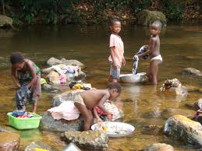
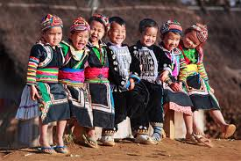
wGojfb Û
Df]/f] t eGg] s'/f ;lsof], tkfO{sf] ;f]Wg' kg]{ s]xL af+sL lyof] ls<<<<<

